Slide 1
Alliance College Alumni Association General Meeting 2024
Mike Anderson

Slide 2
Agenda
President’s Report Mike Anderson
Approve August 23, 2024 Minutes
Financial Report Louis Sitnik
Membership Report Marcia Pilkiewicz
Website Update Website Committee
Reunion Update Reunion Committee
Newsletter Aundrea Heschmeyer
Other Alumni Outreach Suggestions All
Legacy Preservation Mike Anderson
ACAA Foundation Update Richard Day
New Business / Open Topics All

Slide 3
Agenda
President’s Report Mike Anderson
Approve August 23, 2024 Minutes
Financial Report Louis Sitnik
Membership Report Marcia Pilkiewicz
Website Update Website Committee
Reunion Update Reunion Committee
Newsletter Aundrea Heschmeyer
Other Alumni Outreach Suggestions All
Legacy Preservation Mike Anderson
ACAA Foundation Update Richard Day
New Business / Open Topics All

Slide 4
Agenda
President’s Report Mike Anderson
Approve August 23, 2024 Minutes
Financial Report Louis Sitnik
Membership Report Marcia Pilkiewicz
Website Update Website Committee
Reunion Update Reunion Committee
Newsletter Aundrea Heschmeyer
Other Alumni Outreach Suggestions All
Legacy Preservation Mike Anderson
ACAA Foundation Update Richard Day
New Business / Open Topics All

Slide 5
Agenda
President’s Report Mike Anderson
Approve August 23, 2024 Minutes
Financial Report Louis Sitnik
Membership Report Marcia Pilkiewicz
Website Update Website Committee
Reunion Update Reunion Committee
Newsletter Aundrea Heschmeyer
Other Alumni Outreach Suggestions All
Legacy Preservation Mike Anderson
ACAA Foundation Update Richard Day
New Business / Open Topics All

Slide 6
Treasurer’s Report
January, 2025
Role Transition
Lou Sitnik took over as Treasurer in September, 2024
Cash Position as of January, 2025 (as of 1/13/2025)
$ 2,693.76 Checking
$ 15,512.06 Savings
$ 18,115.82 Total
Revenue
$1,345.00 Dues received (12) since the reunion, including 2 lifetime memberships
$1,437.38 Revenue from merchandise sales
Expenses
$159.90 Annual Zoom License
$563.43 Quickbooks Subscription
$1,963.50 Marquee Creative (Marketing activities including website redesign)
$56.08 Paypal Fees
$2,742.91 Total expenses since reunion
Respectfully Submitted,
Louis P. Sitnik, ‘86
Treasurer

Slide 7
Agenda
President’s Report Mike Anderson
Approve August 23, 2024 Minutes
Financial Report Louis Sitnik
Membership Report Marcia Pilkiewicz
Website Update Website Committee
Reunion Update Reunion Committee
Newsletter Aundrea Heschmeyer
Other Alumni Outreach Suggestions All
Legacy Preservation Mike Anderson
ACAA Foundation Update Richard Day
New Business / Open Topics All

Slide 8
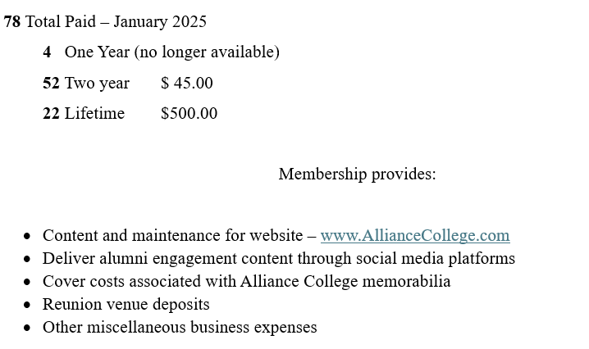
Membership

Slide 9
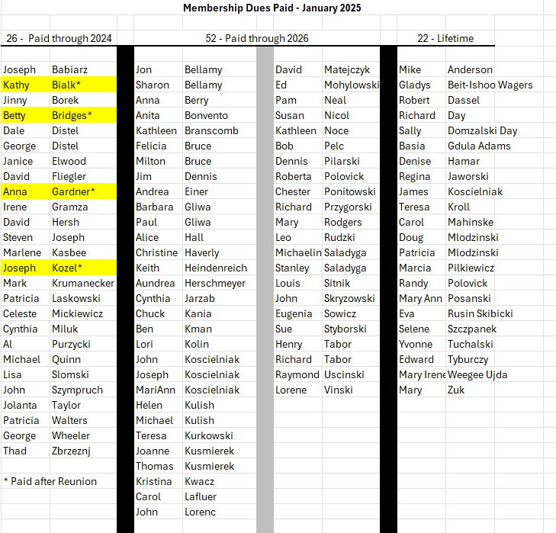
The only people listed in the paid thru 2024 column whose dues is current are the highlighted names
For the others, dues renewal costs
$45/2 yrs
or $500
lifetime

Slide 10
Agenda
President’s Report Mike Anderson
Approve August 23, 2024 Minutes
Financial Report Louis Sitnik
Membership Report Marcia Pilkiewicz
Website Update Website Committee
Reunion Update Reunion Committee
Newsletter Aundrea Heschmeyer
Other Alumni Outreach Suggestions All
Legacy Preservation Mike Anderson
ACAA Foundation Update Richard Day
New Business / Open Topics All

Slide 11
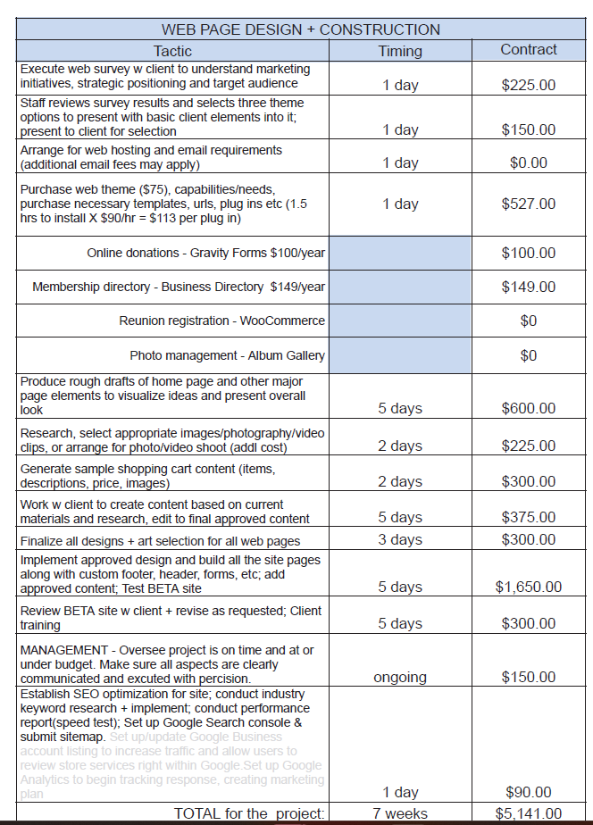
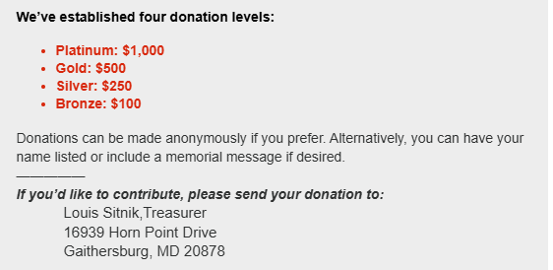
Website
Please make your check out to Alliance College Alumni Association and send to Lou at the above address

Slide 12
Agenda
President’s Report Mike Anderson
Approve August 23, 2024 Minutes
Financial Report Louis Sitnik
Membership Report Marcia Pilkiewicz
Website Update Website Committee
Reunion Update Reunion Committee
Newsletter Aundrea Heschmeyer
Other Alumni Outreach Suggestions All
Legacy Preservation Mike Anderson
ACAA Foundation Update Richard Day
New Business / Open Topics All

Slide 13
Agenda
President’s Report Mike Anderson
Approve August 23, 2024 Minutes
Financial Report Louis Sitnik
Membership Report Marcia Pilkiewicz
Website Update Website Committee
Reunion Update Reunion Committee
Newsletter Aundrea Heschmeyer
Other Alumni Outreach Suggestions All
Legacy Preservation Mike Anderson
ACAA Foundation Update Richard Day
New Business / Open Topics All

Slide 14
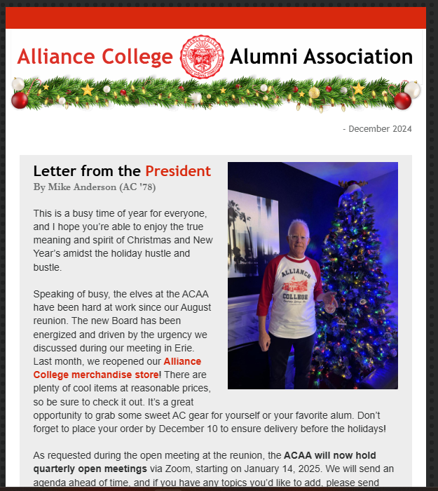
Newsletter

Slide 15
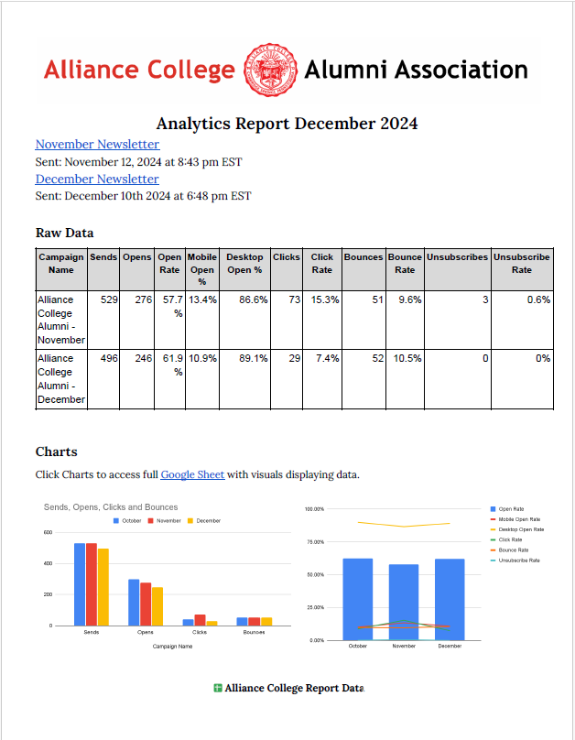
Newsletter

Slide 16
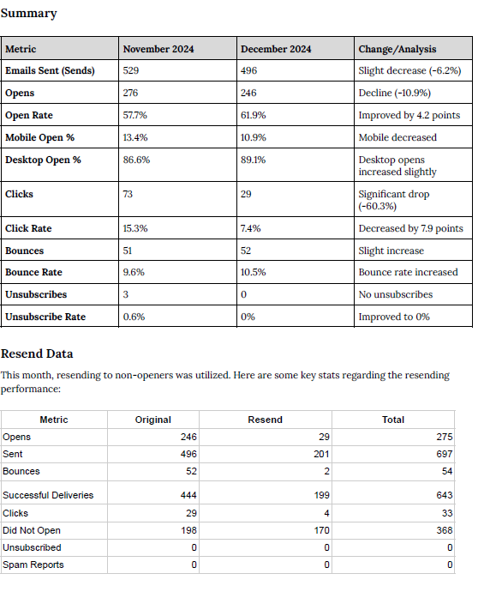
Newsletter

Slide 17
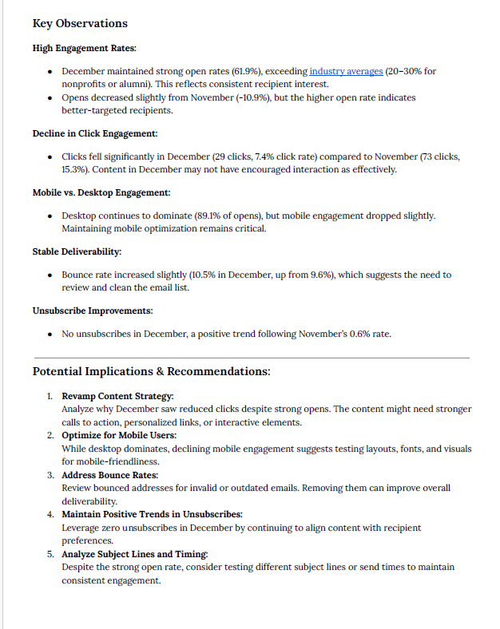
Newsletter

Slide 18
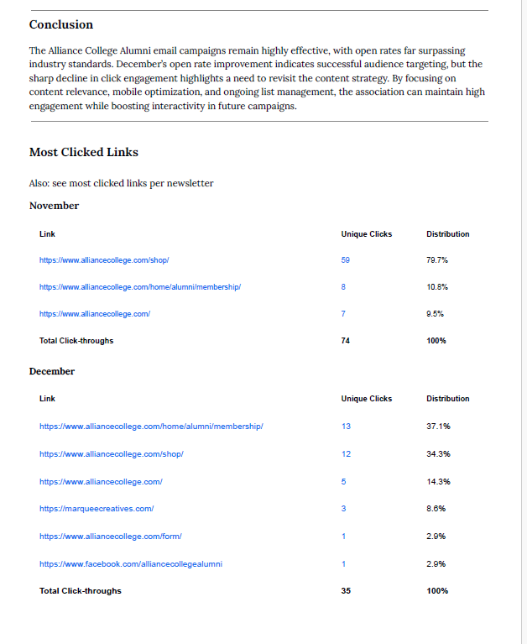
Newsletter

Slide 19
Agenda
President’s Report Mike Anderson
Approve August 23, 2024 Minutes
Financial Report Louis Sitnik
Membership Report Marcia Pilkiewicz
Website Update Website Committee
Reunion Update Reunion Committee
Newsletter Aundrea Heschmeyer
Other Alumni Outreach Suggestions All
Legacy Preservation Mike Anderson
ACAA Foundation Update Richard Day
New Business / Open Topics All

Slide 20
Agenda
President’s Report Mike Anderson
Approve August 23, 2024 Minutes
Financial Report Louis Sitnik
Membership Report Marcia Pilkiewicz
Website Update Website Committee
Reunion Update Reunion Committee
Newsletter Aundrea Heschmeyer
Other Alumni Outreach Suggestions All
Legacy Preservation Mike Anderson
ACAA Foundation Update Richard Day
New Business / Open Topics All

Slide 21
Agenda
President’s Report Mike Anderson
Approve August 23, 2024 Minutes
Financial Report Louis Sitnik
Membership Report Marcia Pilkiewicz
Website Update Website Committee
Reunion Update Reunion Committee
Newsletter Aundrea Heschmeyer
Other Alumni Outreach Suggestions All
Legacy Preservation Mike Anderson
ACAA Foundation Update Richard Day
New Business / Open Topics All

Slide 22
Agenda
President’s Report Mike Anderson
Approve August 23, 2024 Minutes
Financial Report Louis Sitnik
Membership Report Marcia Pilkiewicz
Website Update Website Committee
Reunion Update Reunion Committee
Newsletter Aundrea Heschmeyer
Other Alumni Outreach Suggestions All
Legacy Preservation Mike Anderson
ACAA Foundation Update Richard Day
New Business / Open Topics All

Slide 23
Adjourn
Next Meeting
April 8, 2024
6:30 PM EST
Thanks for attending
Tell your friends

